Slide 1
Redux With React

Slide 2
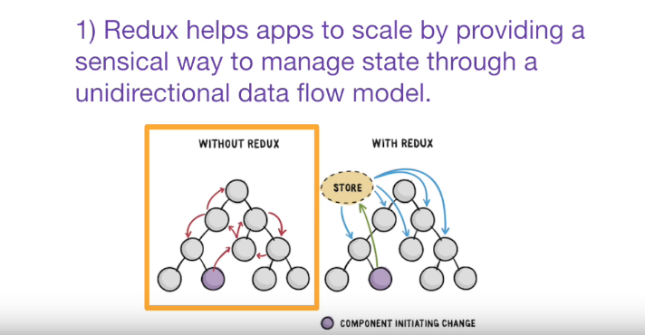
What is Redux

Slide 3
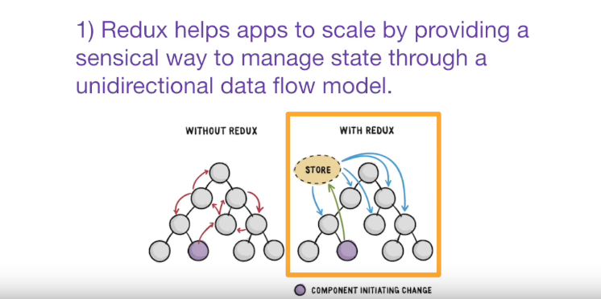

Slide 4
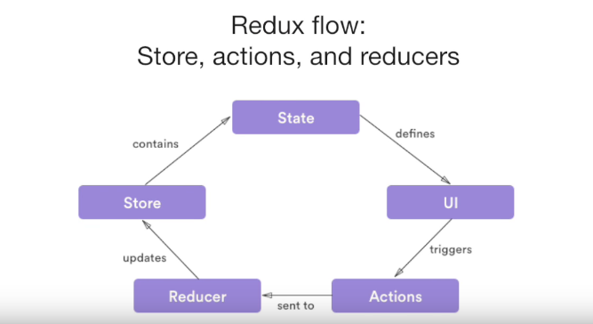

Slide 5
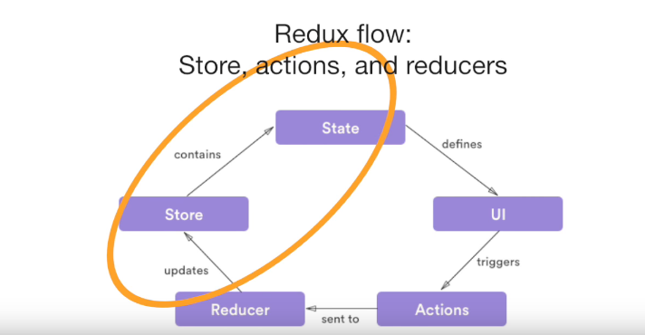
Notes:
Store is where the entire state of the App lives , its basically just one big object

Slide 6
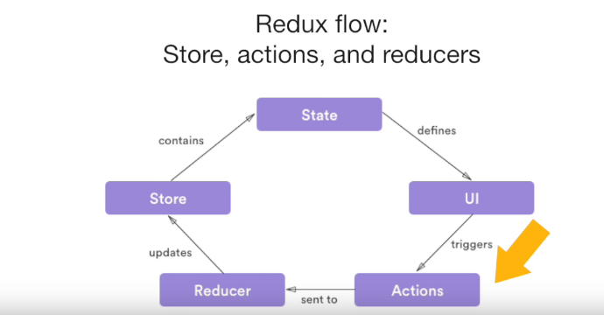
Notes:
Actions are send or dispatched from the views which are payloads for the reducer .

Slide 7
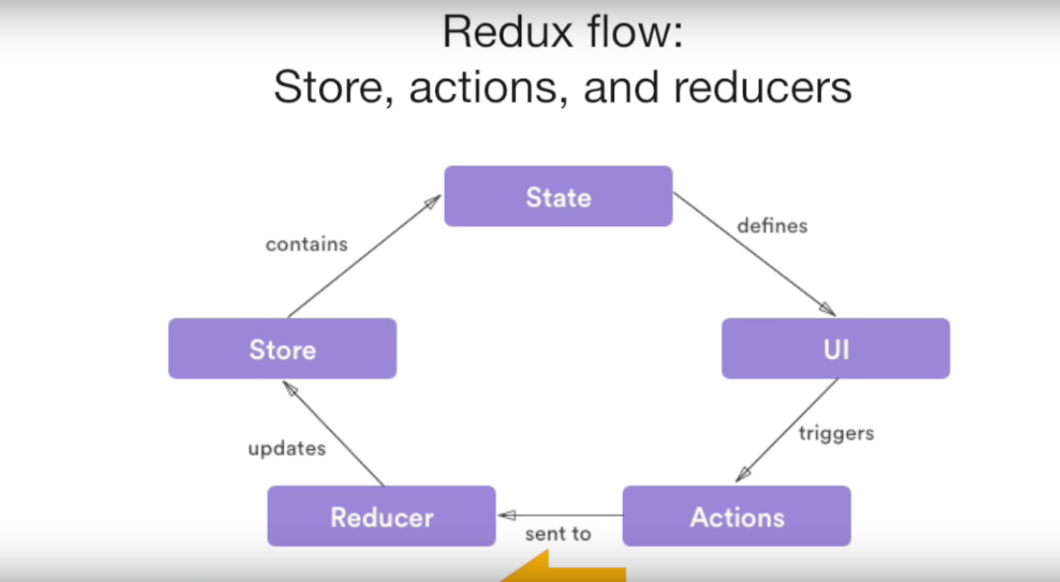
Notes:
Reducers take the payload from the action and then update the store

Slide 8
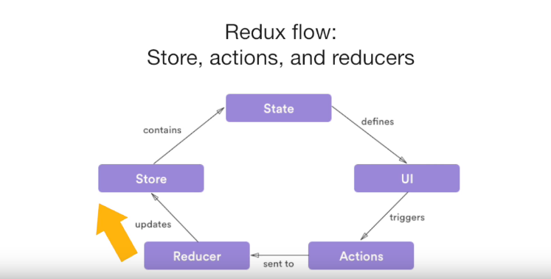
Notes:
Reducer takes the payload and update the store which in turn update the states accordingly.

Slide 9
Redux in Action
We need two Libraries - redux and react-redux
Why
Redux lib gives you a store, and lets you keep state in it, and get state out, and respond when the state changes.But that’s all it does.
It’s actually react-redux that lets you connect pieces of the state to React components.
That’s right: redux knows nothing about React at all

Slide 10

What to change in react component
Step 1
First import Connect function from react-redux
What’s connect?
Connect function hook into Redux(connect pulls data from the Redux store), pull out the entire state, and pass it through the mapStateToProps function that you provide.
Notes:
You might notice the call looks little… weird. Why connect(mapStateToProps)(Counter) and not connect(mapStateToProps, Counter) or connect(Counter, mapStateToProps)? What’s that doing?
It’s written this way because connect is a higher-order function, which is a fancy way of saying it returns a function when you call it. And then calling that function with a component returns a new (wrapped) component.

Slide 11

What to change in react component
Step 2
Write mapStateToProps function.
What does mapStateToProps do?
The object you return from mapStateToProps gets fed into your component as props. The example above will pass state.count as the value of the count prop: the keys in the object become prop names, and their corresponding values become the props’ values. So you see, this function literally defines a mapping from state into props.

Slide 12

Set up Store
Step 1
Create Store
Redux comes with a handy function that creates stores, and it’s called createStore.
Redux makes zero assumptions about the shape of your state. It’s up to you! It could be an object, or a number, or a string, or whatever you need. So we have to provide a function that will return the state.
That function is called a reducer (we’ll see why in a minute). So let’s make the simplest one possible, pass it into createStore

Slide 13

Set up Store
Step 2
Add Provider Component
What is Provider?
Redux holds the global state for the entire app, and by wrapping the entire app with the Provider component from react-redux, every component in the app tree will be able to use connect to access the Redux store if it wants to.
It’s like a secret passageway connected to every component, and using connect opens the door to the passageway.

Slide 14
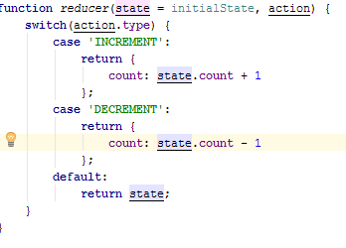
Reducers
Step 1
Make Reducer fucntions
What Are Reducer Functions?
It takes the current state and an action, and then it returns the new state.
Have to keep in mind of immutability use object.assign function or immutable.js .
The Default case should always be present.

Slide 15
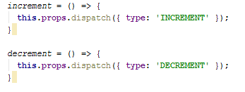
Create Actions
Step 1
Create Actions
What are Actions?
An “action” is a JS object that describes a change that we want to make.
The only requirement is that the object needs to have a type property, and its value should be a string
You can call actions from React Component using Dispatch function.

Slide 16
Going through lifecycle again

Slide 17
Thanks

Slide 18
Feedback
Pro
Cons

